Slide 1
[320] Web 2: Flask
Department of Computer Sciences
University of Wisconsin-Madison

Slide 2


Getting Requests Through
[like street address]
IP address: 18.216.110.65
processes
request for data to 18.216.110.65
Python
computer 1
(laptop)
computer 2
(Virtual Machine)
Scenario: we want to access Jupyter on our virtual machine from our laptop

Slide 3
Getting Requests Through
[like street address]
IP address: 18.216.110.65
request for data to 18.216.110.65:2020
processes
[ports are like
apartment numbers]
Python
computer 1
(laptop)
computer 2
(Virtual Machine)
Scenario: we want to access Jupyter on our virtual machine from our laptop

Slide 4
Getting Requests Through
IP address: 18.216.110.65
18.216.110.65:22
SSH
port 22
18.216.110.65:2020
processes
Python
computer 1
(laptop)
computer 2
(Virtual Machine)
Issue 1: firewall may be blocking some ports (we disabled this in lab)

Slide 5
Getting Requests Through
IP address: 18.216.110.65
18.216.110.65:22
SSH
port 22
18.216.110.65:2020
processes
Python
computer 1
(laptop)
computer 2
(Virtual Machine)
Issue 2: there might not be any process listening on port 2020

Slide 6
Getting Requests Through
[127.0.0.1 means "localhost", the default]
Start command: python3 -m notebook --no-browser --ip=127.0.0.1 --port=2020
IP address: 18.216.110.65
18.216.110.65:22
SSH
port 22
18.216.110.65:2020
Jupyter
processes
port 2020
Python
computer 1
(laptop)
computer 2
(Virtual Machine)
Issue 3: the process may only be listening for local (not external) requests

Slide 7
Getting Requests Through
[0.0.0.0 means all IP addresses]
Start command: python3 -m notebook --no-browser --ip=0.0.0.0 --port=2020
IP address: 18.216.110.65
18.216.110.65:22
SSH
port 22
18.216.110.65:2020
Jupyter
processes
port 2020
Python
computer 1
(laptop)
computer 2
(Virtual Machine)
Success: Jupyter is listening for all 2020 requests, and the firewall isn't blocking them!

Slide 8
Getting Requests Through
Start command: python3 -m notebook --no-browser --ip=0.0.0.0 --port=2020
IP address: 18.216.110.65
18.216.110.65:22
SSH
port 22
18.216.110.65:2020
Jupyter
processes
port 2020
Python
18.216.110.65:8000
http.server
port 8000
computer 1
(laptop)
computer 2
(Virtual Machine)
mkdir -p demo
cd demo
echo "<b>Hello</b> world!" > index.html
sudo python3 -m http.server --bind=0.0.0.0 8000
Demo: start web server with http.server

Slide 9
Getting Requests Through
Start command: python3 -m notebook --no-browser --ip=0.0.0.0 --port=2020
IP address: 18.216.110.65
18.216.110.65:22
SSH
port 22
18.216.110.65:2020
Jupyter
processes
port 2020
Python
P4
18.216.110.65:5000
port 5000
computer 1
(laptop)
computer 2
(Virtual Machine)
Your Goal: build a web application for P4

Slide 10
DNS (Domain Name Service)
go to: example.com
IP address: 18.216.110.65
Python Server
(3) send request to 18.216.110.64
(2) it's at 18.216.110.64
(1) lookup
example.com
IP address: 8.8.8.8
{
"example.com": "18.216.110.64",
...
}
computer 2
(Virtual Machine)
paying to register domain name is ~$10-15 / year

Slide 11
HTTPS: Hypertext Transfer Protocol Secure
go to: example.com
IP address: 18.216.110.65
HTTP traffic
Python Server
snoop
Wireshark
computer 2
(Virtual Machine)

Slide 12
HTTPS: Hypertext Transfer Protocol Secure
go to: example.com
IP address: 18.216.110.65
HTTPS traffic
Python Server
cannot read
encrypted traffic
Wireshark
computer 2
(Virtual Machine)
paying to register SSL certificate for encryption name is ~$5-10 / year
(or free: https://letsencrypt.org/)

Slide 13
Pages vs. Files

Slide 14
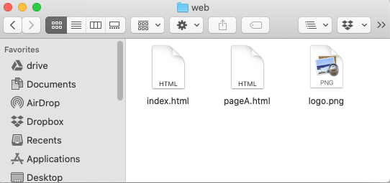
Static Pages Correspond to Files
IP address: 18.216.110.65
18.216.110.65:8000/pageA.html
Python Server
read
Python Server Code (approximate)
computer 2
(Virtual Machine)
def get_page(resource):
with open(resource, "rb") as f:
return f.read()

Slide 15
Static Pages Correspond to Files
IP address: 18.216.110.65
18.216.110.65:8000/logo.png
Python Server
read
Python Server Code (approximate)
computer 2
(Virtual Machine)
def get_page(resource):
with open(resource, "rb") as f:
return f.read()

Slide 16
Static Pages Correspond to Files
IP address: 18.216.110.65
18.216.110.65:8000/
Python Server
read
Python Server Code (approximate)
computer 2
(Virtual Machine)
def get_page(resource):
if resource == "/":
resource = "index.html"
with open(resource, "rb") as f:
return f.read()

Slide 17
Dynamic Pages Generated by Code
IP address: 18.216.110.65
18.216.110.65:8000/ha.html
Python Server
Python Server Code (approximate)
computer 2
(Virtual Machine)
def get_page(resource):
if resource == "/ha.html":
return "<b>Ha!</b>" * 100
with open(resource, "rb") as f:
return f.read()
ha.html is dynamic
others are static

Slide 18
Templating: Add Dynamic Content to File
IP address: 18.216.110.65
18.216.110.65:8000/pageA.html
Python Server
read
<html>
<body>Hi Gurmail, don’t forget to check the output of the pipelines for your projects.
</body>
</html>
<html>
<body>Hi {}, don’t forget to check the output of the pipelines for your projects.
</body>
</html>
Python Server Code (approximate)
computer 2
(Virtual Machine)
def get_page(resource):
with open(resource, "rb") as f:
s = f.read()
if resource = "/pageA.html":
s = s.format(date.today())
return s

Slide 19
Multi-File Pages

Slide 20
Page Load, the Big Picture
IP address: 18.216.110.65
index.html, please [GET]
computer 1
(laptop)
computer 2
(Virtual Machine)

Slide 21
Page Load, the Big Picture
IP address: 18.216.110.65
index.html, please [GET]
<html>
<body>
<img src="A.png">
<b>Hello</b>
<script src="B.js">
</script>
</body>
</html>
computer 1
(laptop)
computer 2
(Virtual Machine)

Slide 22
Page Load, the Big Picture
IP address: 18.216.110.65
index.html, please [GET]
<html>
<body>
<img src="A.png">
<b>Hello</b>
<script src="B.js">
</script>
</body>
</html>
A.png, please [GET]
B.js please [GET]
computer 1
(laptop)
computer 2
(Virtual Machine)

Slide 23
Page Load, the Big Picture
IP address: 18.216.110.65
index.html, please [GET]
<html>
<body>
<img src="A.png">
<b>Hello</b>
<script src="B.js">
</script>
</body>
</html>
A.png, please [GET]
B.js please [GET]
computer 1
(laptop)
computer 2
(Virtual Machine)

Slide 24
Page Load, the Big Picture
IP address: 18.216.110.65
index.html, please [GET]
A.png, please [GET]
Hello
B.js please [GET]
JavaScript (B.js)
computer 1
(laptop)
computer 2
(Virtual Machine)

Slide 25
Page Load, the Big Picture
IP address: 18.216.110.65
index.html, please [GET]
A.png, please [GET]
Hello
B.js please [GET]
data.json please [GET]
JavaScript (B.js)
computer 1
(laptop)
computer 2
(Virtual Machine)

Slide 26
Page Load, the Big Picture
IP address: 18.216.110.65
index.html, please [GET]
A.png, please [GET]
Hello
B.js please [GET]
data.json please [GET]
JavaScript (B.js)
computer 1
(laptop)
computer 2
(Virtual Machine)

Slide 27
Page Load, the Big Picture
IP address: 18.216.110.65
index.html, please [GET]
A.png, please [GET]
Hello
B.js please [GET]
data.json please [GET]
JavaScript (B.js)
computer 1
(laptop)
computer 2
(Virtual Machine)

Slide 28
Page Load, the Big Picture
IP address: 18.216.110.65
index.html, please [GET]
A.png, please [GET]
Hello
B.js please [GET]
data.json please [GET]
JavaScript (B.js)
here's some data [POST]
computer 1
(laptop)
computer 2
(Virtual Machine)
Building a dashboard or similar app will involve many routes/requests

Slide 29
Summary: Key Web Concepts
IP address: identifier for a computer (or network card on computer)
port number: identifier used to route to specific process on computer
firewall: software to block certain requests, often for certain ports
listening: process is ready to receive requests from an IP/port
DNS: service for converting domains to IP addresses
HTTPS: encrypted HTTP traffic so others can't watch traffic on WIFI, etc
static pages: pages that correspond to files on the server
dynamic pages: pages generated on-the-fly by some Python code
templating: insert dynamic content into certain places in a file
HTTP GET: request to download data
HTTP POST: request to upload data

Slide 30
Web Frameworks

Slide 31
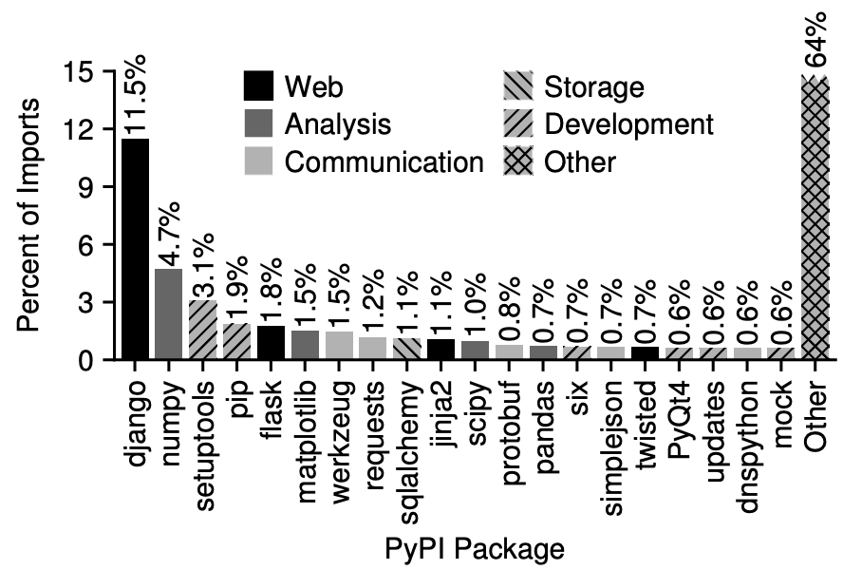
Python Web Frameworks (and other packages)
Python web frameworks like Flask and Django make it easy to write functions for each webpage that can return a string with the contents.
we'll use Flask
for CS 320 because
it is simpler than Django
https://www.usenix.org/system/files/conference/atc18/atc18-oakes.pdf

Slide 32
Flask Example
Start from lecture snippets

Slide 33
Decorators

Slide 34
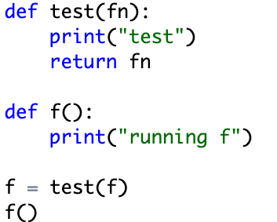
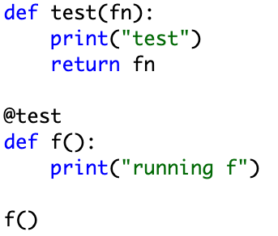
Decorators: take a function, return a function
@name before a function "decorates" a function
Useful for (a) making lists of certain types of functions, or (b) modifying functions

Slide 35
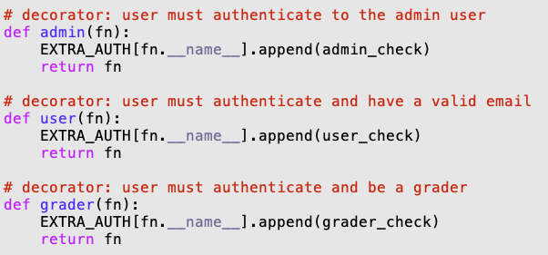
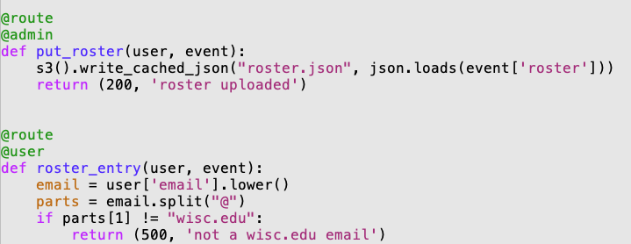
Example from Course Website

Slide 36
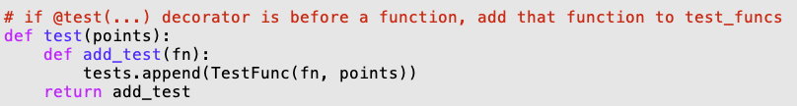
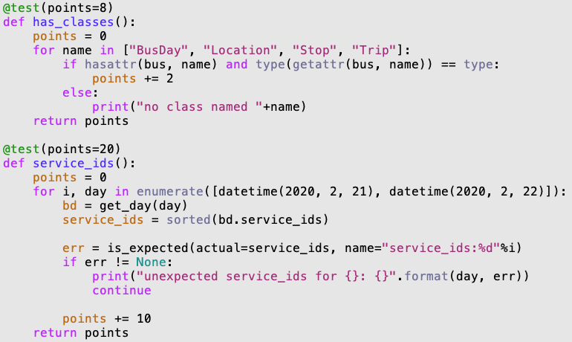
Example: Test Caller

Slide 37
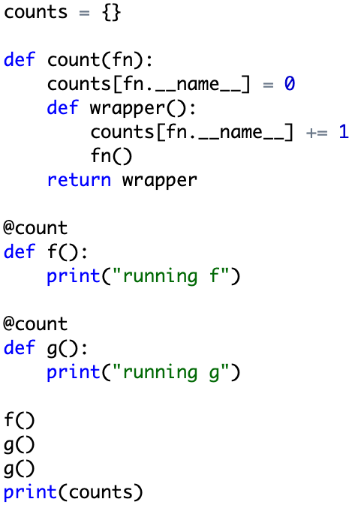
Example: Invocation Counter

